Slide 1


Fundamentals of RM
RM System and Process
Leadership in RM
Incident Investigation
RM Tools & Challenges
RM in Industry
People & Org.
Applications & Perspectives
On Becoming a Leader in Risk Management
ENGG404 - Lecture
Expectations and Instructions For Writing the Final Exam
1
Notes:
ENGG404 Lecture 00 - Day 1
2012 Fall
1
1

Slide 2
Key Points about Writing the Exam:
This PPT is posted on the ENGG404 Resources for Students Shared Drive.
As such, minimal time will be spent on the slides except as noted:
Purpose of this lecture: Communicate the expectations for the Final Exams.
Learning Outcomes of this lecture: Plan for and meet the expectations for writing the final exam.
The final exam is cumulative: in order to master lecture content in the latter part of the term one should be competent in the content covered prior to the mid-term exam.
If you are regularly attending and engaging yourself, then there will be no surprises on the final exam.
The final exam duration is 180 minutes (3 hours).
Expectations for the Final Exam
2
Notes:
2

Slide 3
Key Points about Writing the Exam:
Recall from Lecture #1, that the first question on the exam is: “What are the four key points of the Engineer’s Survival Guide?”
You will need to know details about the case studies discussed in class as well as your team project case study.
I will not ask specific details about course case studies i.e. I won’t ask “When did the Loss Incident occur?”
But you will be expected to apply key principles of risk management and the key lessons derived from the case studies above.
Expectations for the Final Exam
3
Notes:
3

Slide 4
Key Points about Writing the Exam:
The final exam will be administered at The Learning Assessment Centre, using the MOODLE-eClass platform on secured work-stations. The mechanics for doing the final exam are the same as the mid-term exam.
You should expect / have already received an email from The LAC that will direct you to sign onto the LAC booking site, and book your preferred time for writing the mid-term exam.
Final exam will be per the Course Plan. You will have your choice of day and several time slots in which to write the exam.
Expectations for the Final Exam
4
Notes:
4

Slide 5
Key Points about Writing the Exam:
Space is limited so it is advisable to book sooner rather than later.
If you do NOT book to reserve your place at least one week prior to the exam date, there may not be any time slots remaining at your preferred time, and you will be required to write at a time within the window other than your preference.
If you miss writing on the day of the final exam for non-excusable reasons, you may be assessed 0% on the final exam. Extenuating circumstances per the University Policy.
ALLOWABLE ITEMS: pen/pencil, scientific calculator, bottled water.
PROHIBITED: any other electronic devices, books, notes, aid sheets, etc. and as may be specified by LAC. NO FOOD OR OTHER BEVERAGES.
A secure area is available for you to store your back-packs, purses, brief cases, etc.
5
Notes:
5

Slide 6

Key Points about Writing the Exam:
For more information, GO HERE: https://ist.ualberta.ca/services/learning-assessment-centre/students
6
Notes:
6

Slide 7
Key Points about Writing the Exam:
You should plan to arrive at least 10 minutes prior to your scheduled time slot in order to check into The LAC.
If there are unforeseen circumstances that delay your arrival, notify The LAC upon your late arrival.
You MUST have your STUDENT ID card.
If you don’t have it with you, you don’t get in to write the exam.
If you have lost your Student ID card, get a new one!
7
Notes:
7

Slide 8
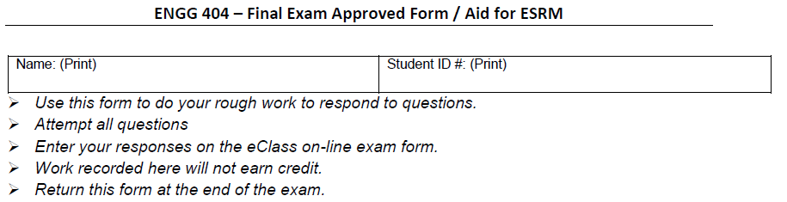
Key Points about Writing the Exam:
When you arrive, you will be “checked in”. LAC will confirm your identity and eligibility to write the exam.
LAC will provide you with one sheet of paper for rough work.
You must return this when you leave the LAC.
You will be seated at a secure work-station, and will be signed in.
8
Notes:
8

Slide 9
Key Points about Writing the Exam:
During the exam:
Place your ONEcard - picture side up - on your desk.
No talking.
You may not leave the LAC - even for the washroom - until your exam is completed per LAC rules.
9
Notes:
9

Slide 10
Academic Integrity and Ethical Conduct:
The exam paper is “Confidential – Do NOT Share”.
You will be asked to confirm your understanding of the academic honesty statement:
I understand that it is important that the quiz attempt I am about to make is all my own work. I understand what constitutes plagiarism or cheating, and I will not undertake such activities. The University of Alberta is committed to the highest standards of academic integrity and honesty. I understand the Code of Student Behaviour and am aware that all forms of academic misconduct will be addressed
Let me explain what this means to you …
Ethical conduct in the profession and our academic integrity.
You may be helping your friend at your expense!
10
Notes:
10

Slide 11
Academic Integrity and Ethical Conduct:
Q: Thinking about helping your friend by telling them what is on the final exam?
A: DON’T!
Academic dishonesty – violates academic policies.
You are helping your friend at your expense!
The separation between two letter grades is minimal!
11
Notes:
11

Slide 12
Key Points about Writing the Exam:
The final exam duration is 180 minutes (3 hours).
Note that the exam will automatically log any responses and close 180 minutes after the start of the exam.
Regardless of your starting time, you will be allowed a full 150 minutes to write the exam.
Exception: If you arrive too late in the day – LAC closes.
Exception: If you arrive too late after your schedule time as there may not be space to accommodate you – others are booked.
12
Notes:
12

Slide 13
Key Points about Writing the Exam:
The mechanics for doing the final exam i.e. the format, is similar to the mid-term:
Written responses: open text boxes or fill-in-the-blanks (3 questions)
Numerical responses: A blank form for rough work will be provided and MUST be returned.
Multiple choice letters / drop-down / pick-list
Please be aware that a penalty may apply for incorrect responses on multiple-choice questions. These are noted on each question.
No response = no marks earned, no penalty
The number of questions on the exam is immaterial.
What is important … the exam is 180 minutes in duration at ~1-1/4 marks earned per minute, for about 225 marks +/- total.
13
Notes:
13

Slide 14
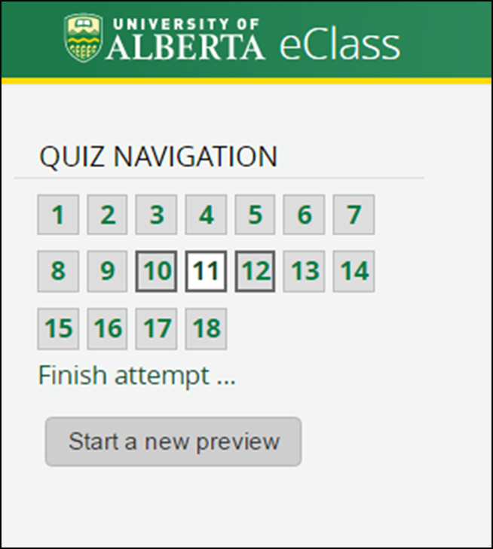
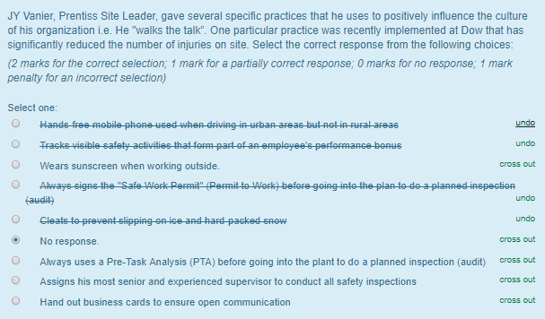
Key Points about Writing the Exam:
To navigate within the exam, look in the upper left corner for the “Quiz Navigation” grid:
Use the “cross out” feature to help you chose your response on multiple choice questions:
14
Notes:
14

Slide 15
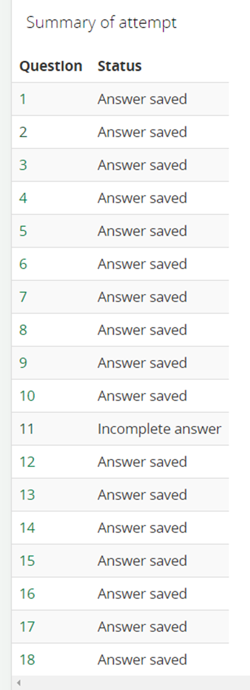
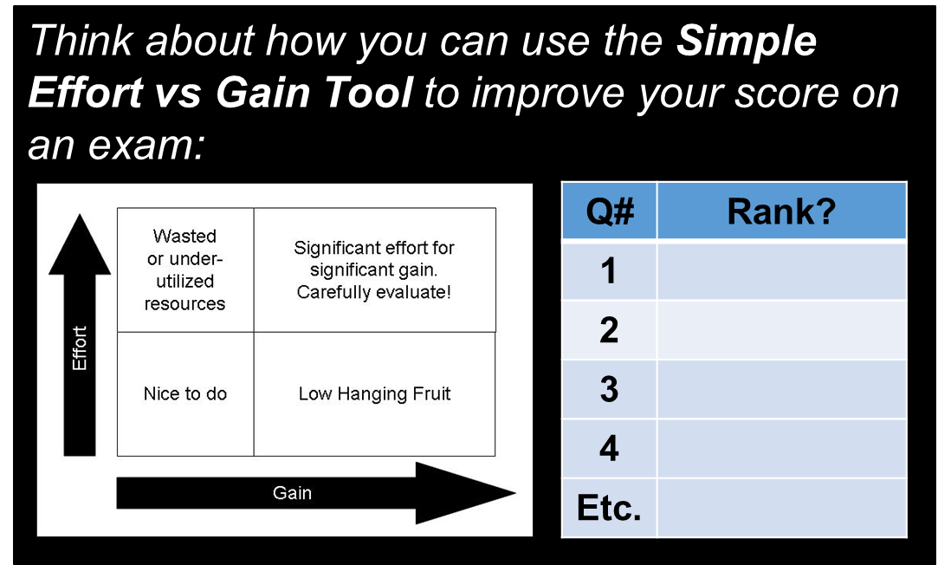
Key Points about Writing the Exam:
To check if you have responded to all questions on the exam:
“Incomplete answer” means that you have not yet attempted that question.
“Answer saved” does not mean that it is correct or that it is complete in all respects.
A list of question numbers and the marks will be provided on the one sheet of paper.
You may wish to “risk rank” to prioritise your questions:
C D F
R S ?
15
Notes:
15

Slide 16
Key Points about Writing the Exam:
After the exam you will:
Verify with a proctor that you have submitted your exam and logged out properly.
Be directed to the reception area to:
Write your name on YOUR form (if given one)
Return YOUR form (if given one)
Sign-out of the LAC with your ONEcard
Retrieve your personal items.
16
Notes:
16

Slide 17
Key Points about Writing the Exam:
After writing the exam and leaving LAC, you might be approached by a class-mate, and be asked about what is on the exam.
“Asking” constitutes academic misconduct and unethical professional conduct.
“Responding” ALSO constitutes academic misconduct and unethical professional conduct.
Both are subject to severe sanctions – failure of this course, suspension, expulsion; inability to qualify for APEGA professional status due to unethical conduct.
So, what should you do?
Do not ask!
Do not respond! If being pestered / if the person is persistent, refuse to respond AND indicate that you will report the individual.
You are allowed to say, “What’s on the exam is exactly what we covered in the lectures.”
17
Notes:
17

Slide 18
Key Points about Writing the Exam:
There is very little to memorize. Recall from Lecture #1, that the first question on the exam is: “What are the four key points of the Engineer’s Survival Guide?”
I will not ask specific details about course case studies i.e. I won’t ask “When did the Loss Incident occur?”
But you will be expected to apply key principles and practices of risk management and the key lessons derived from these case studies.
You should know how to calculate the Injury Frequency Rate: IFR = (number of injuries x 200,000 hours) / (Total exposure hours) per Chapter 2.4: The Importance of Risk Management.
18
Notes:
18

Slide 19
Any questions? (MM-Open)
Notes:
19

